Slide 1


What’s your theory Project
A. Choose a mystery. Work with a partner. Choose a mystery you are interested in. See the list below for ideas or use another mystery you know about.
Our mystery is ______________.
A mysterious place: Stonehenge, the Bermuda Triangle
A mysterious animal or person: the Chupacabra, the Loch Ness monster
A mysterious event: crop circles, the Mary Celeste

Slide 2
Content Note
Some well-known mysteries include:
the Taos hum
the Voynich manuscript
the Lost City of Atlantis
Rongorongo on Easter Island
the Nazca Geoglyphs
Greyfriars Kirkyard in Edinburgh
the Beale Ciphers
the Phaistocs Disc.

Slide 3
What’s your theory Project
B. Research your topic. Think of a list of questions (Who? What? When? Why? Where? How?). Then find answers for them. What’s your theory about the mystery?
Where is Stonehenge?
Why did people make it?
C. Prepare a short presentation. Make a poster or a slideshow to tell other people about your topic.
D. Present your mystery. Explain the mystery and your theory about it to a small group.
Listeners, say what you think about the theory.

Slide 4
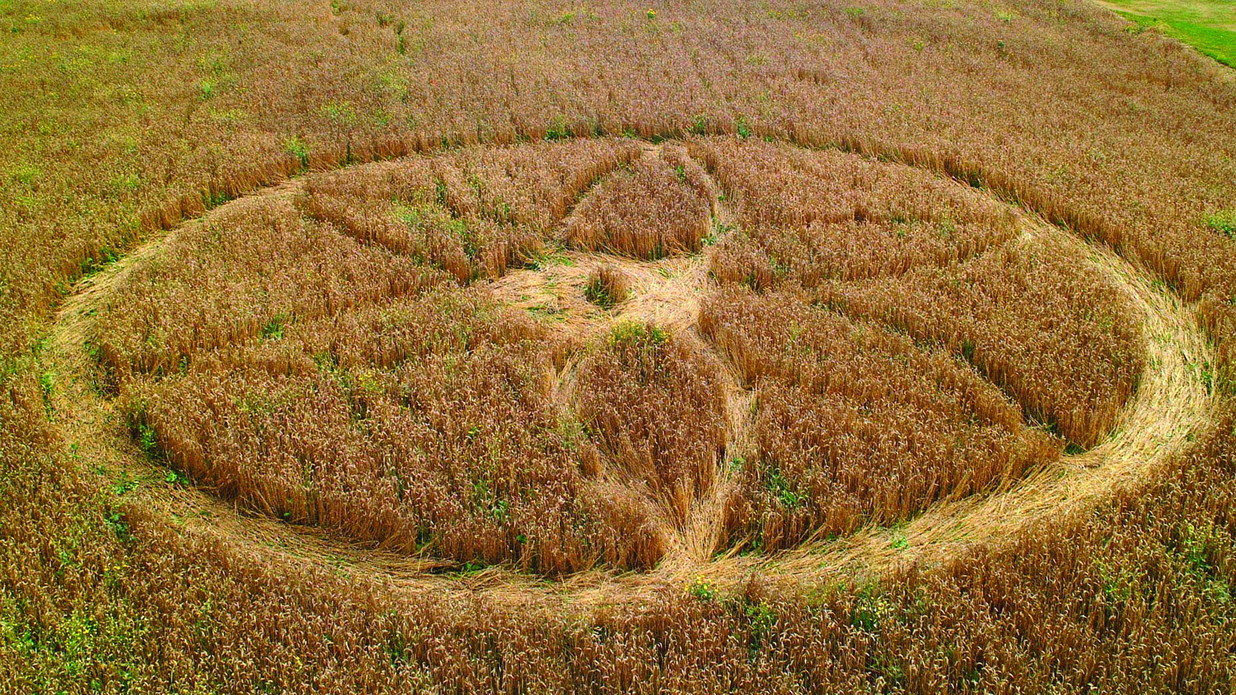
What’s your theory Project
Collect more theories. Interview different people about the mystery above. Find out their theories. Decide which are the most believable or unbelievable theories and share them with the class. Do other students find the theories believable?
This crop circle appeared one night in a garden in England.

